Slide 1
Catherine Laken Jerri Bowling!

Slide 2
I feel it is important to start with my grandparents who are my hero’s in life because without them I would not be here or who I am. My papaw, Jerry Allen Bowens was born on March, 2 1947. He has been a hard worker his whole life and has taught me so much. He is a fantastic story teller and I love to hear him talk about the “good ol’ days.” Time has really changed through the years for him. This man is my best example, best-friend and hero. He met Tamera Jane Conley in Eastern Kentucky when he was delivering groceries to her grandmother. They hit it off and ended up getting married in October, 7 1967.

Slide 3
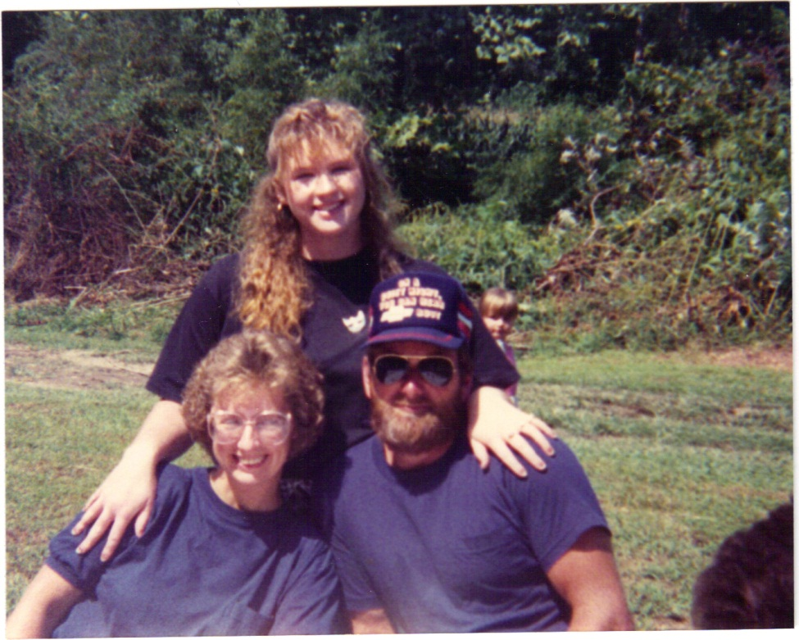
Both young and in love they had their first and only child four years later on October, 9 1981. It’s a girl! They had Tina Marie Bowens who was the joy of their life. She grew up with these two amazing people raising her. She would grow up to be an incredible woman as well. She met and had a crush on a guy she worked with. Things occurred and she became pregnant. To her and the whole families surprise it was twins! A lot of shock and joy was developed.

Slide 4
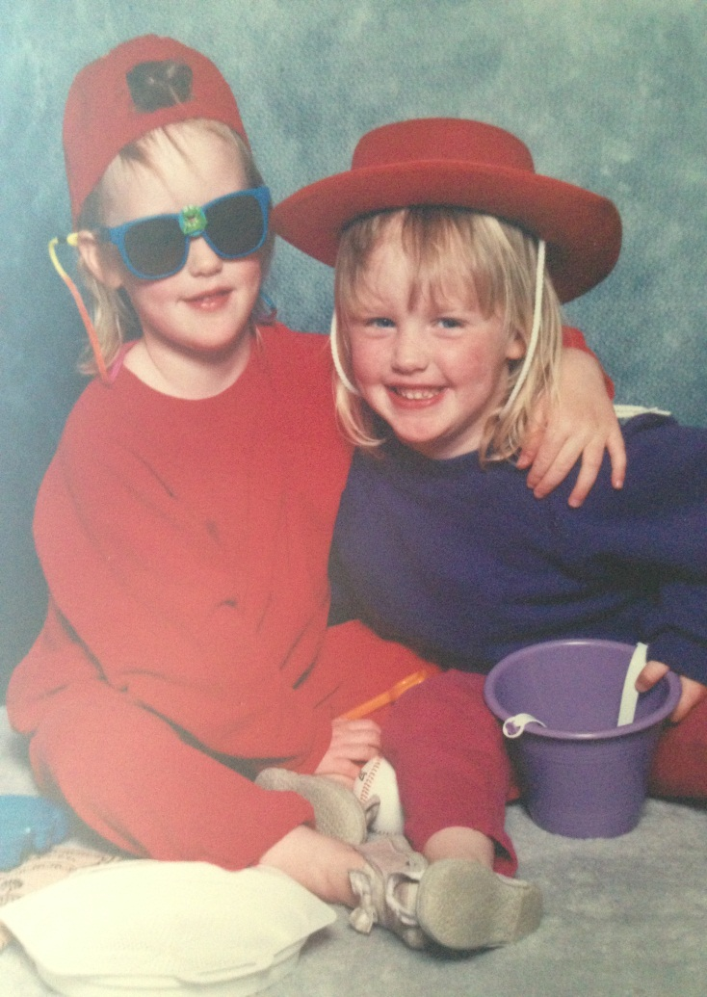
On February, 27 1992 two baby girls were born! Everyone was very excited. They were born eight minutes apart. One twin happened to be underweight but my some small miracle one twin lost a few ounces and the other gained that same amount so they were both good to go home. Caitlin Tamera Paige Bowens was born then Catherine Laken Jerri Bowens.-Caitlin being named after their grandma and Laken being named after their papaw.

Slide 5
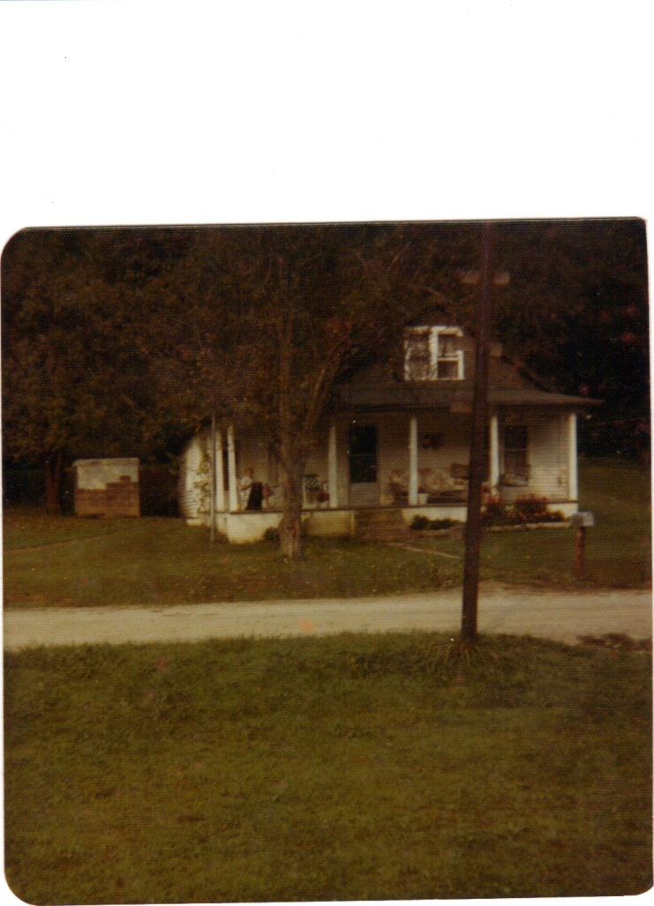
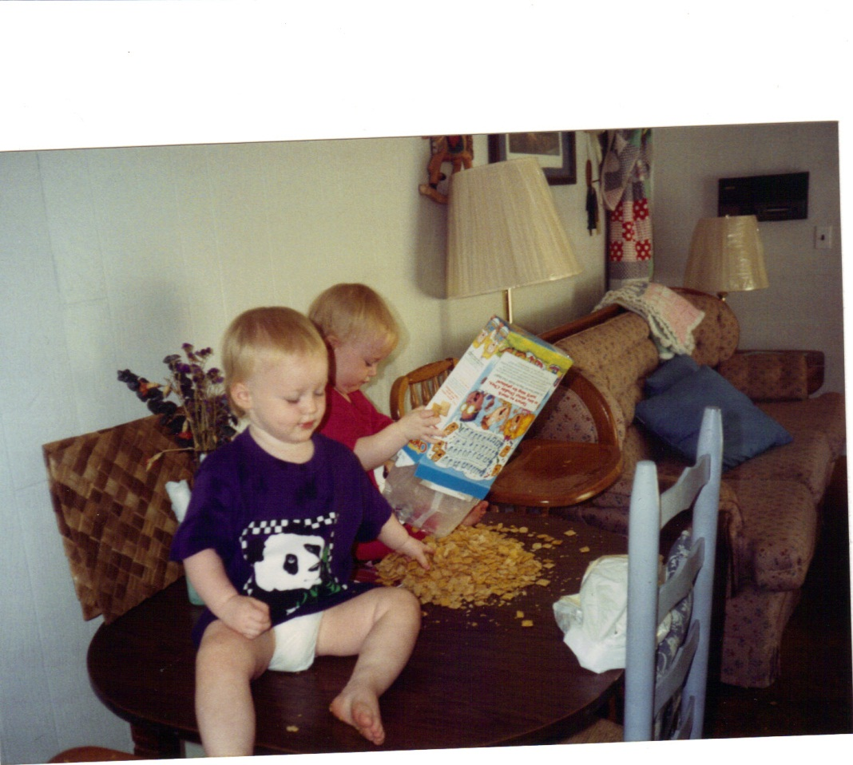
I believe we all know that I am Laken by this point. My family always called me Laken and never called me Catherine. Later in life this would cause a problem for I had not learned to spell my first name until the fourth grade when I needed it for test taking. We lived in the old house across from our grandparents. The old house is where our papaw was born.

Slide 6
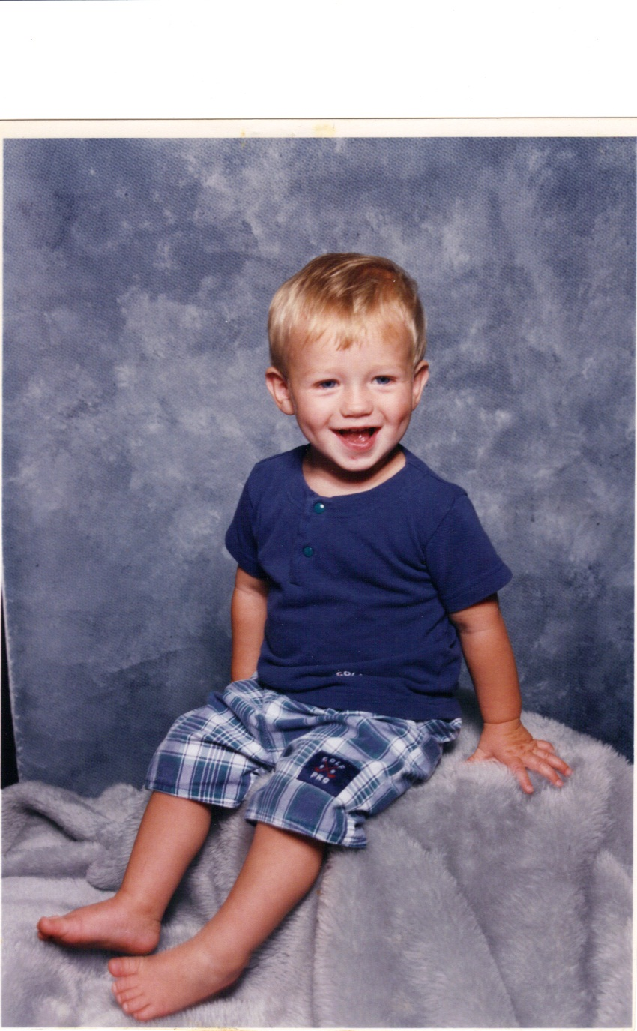
When we were about four years old we moved to Winchester Kentucky to live with our future brother’s dad. On June 14th 1995 I received a baby brother. Throughout his life he would have to deal with two older sisters. I lived in Winchester Kentucky until I reached the fourth grade where my mom moved us to Virginia to live.

Slide 7
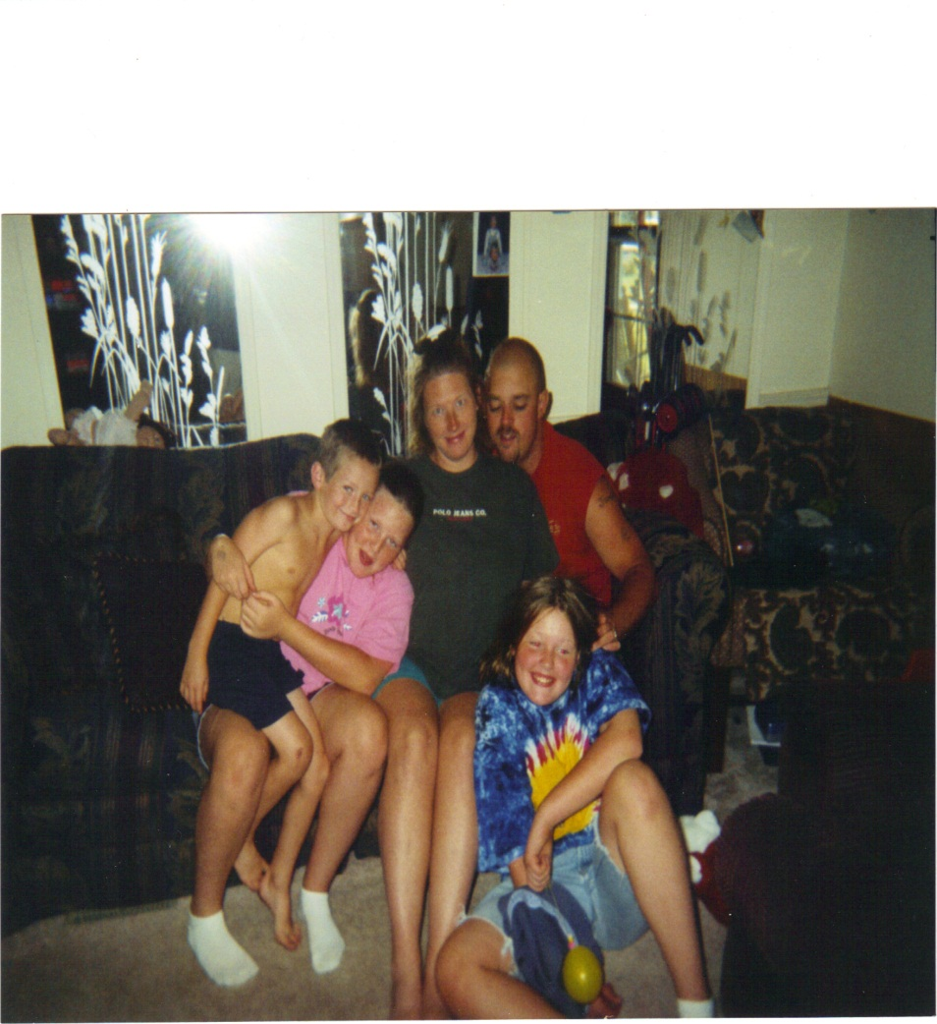
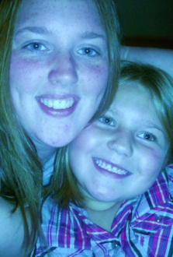
We moved there and this is where I met my father for the first time. I would meet his mom, sisters, my cousins even my great-grandmother on that side. It was a crazy time in my life but very interesting. I would move schools three times in Virginia and move a few times as well. I would gain two siblings, a half-sister and also a new baby sister, Rebecca Bowling. Rebecca would be the best thing I received from this move. My father turned out to be a very abusive man. He would abuse us mentally and physically. It was a time I was mostly scared and sad and wanted more than anything to move to my grandparents. In 2005 with the help of my grandparents and a few of my male cousins my mom got the strength to leave my father. They came to the house, packed all of our things, checked us kids out of school and we moved in with my grandparents in Kentucky. I was happy to be away from a man who caused us much pain and loved living with my grandparents but it was different. Even though Virginia and Kentucky are next to each other the culture is different

Slide 8
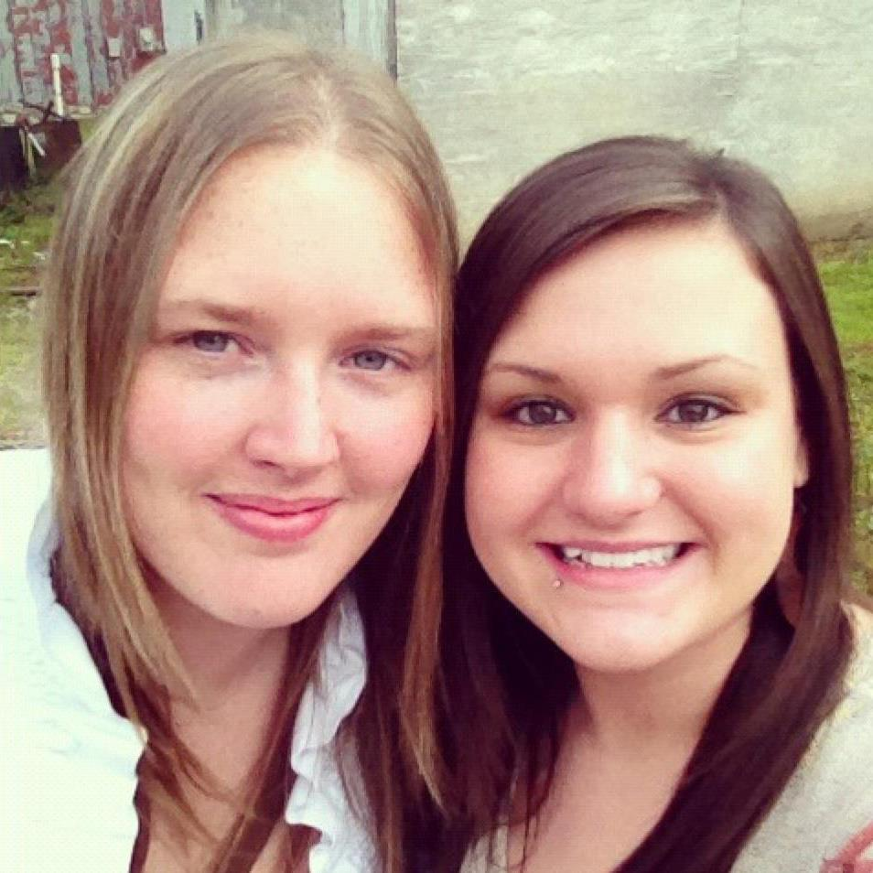
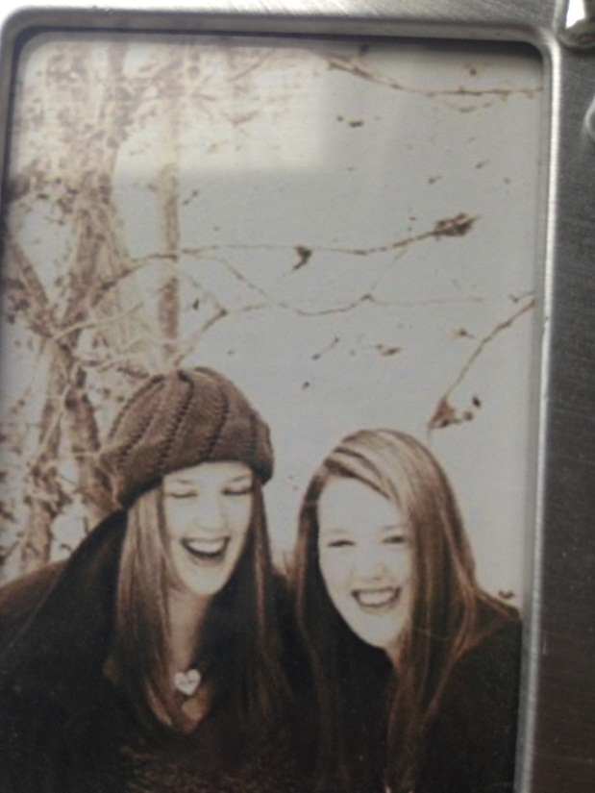
I would finish middle school at the middle school my mom went to, full of people she knew. Everyone loved the fact that my sister and I were tall because this is the state of basketball and they knew they wanted us to play. I would attend high school here too. I would meet my best friend on a school bus ride home and stay friends with her for all of my mortal life. Moving in with my grandparents is the milestone in my life that made me who I am

Slide 9
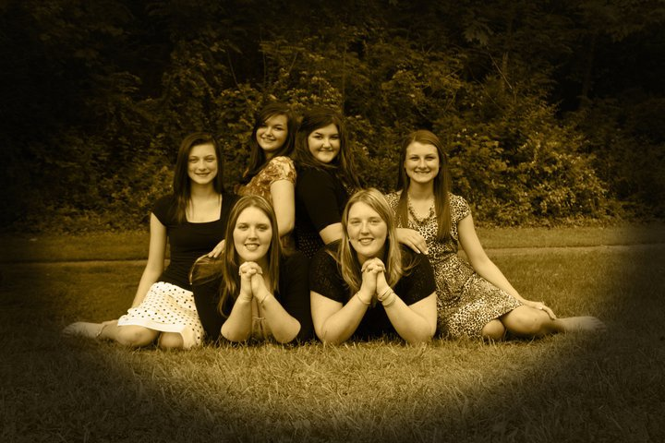
I joined the church with my twin and grandmother. I not only felt like I had the perfect family living with my grandparents I also gained a church family. I grew and learned a lot by being a Mormon. I would stand out but being tall and having a twin I already did. High school was not something I enjoyed very well as a student and is one of the main reason I want to go back to improve it. My senior year I made the decision of applying to BYU-Idaho. My family thought I was nuts. I love home and I am homebody. No one thought I would stay at this school.

Slide 10
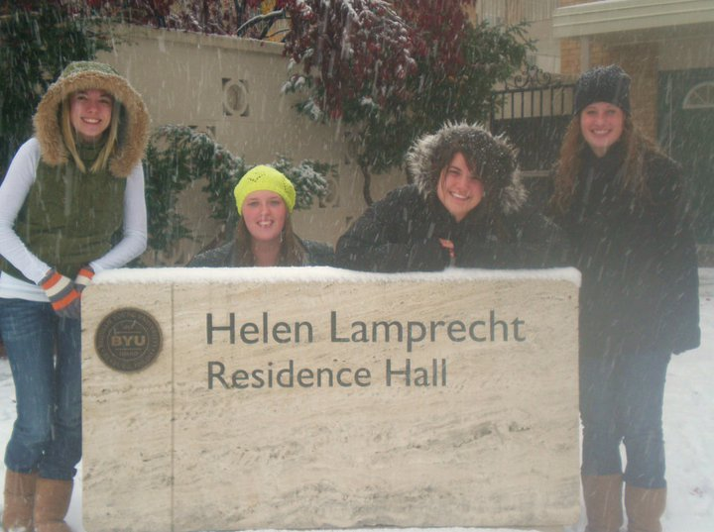
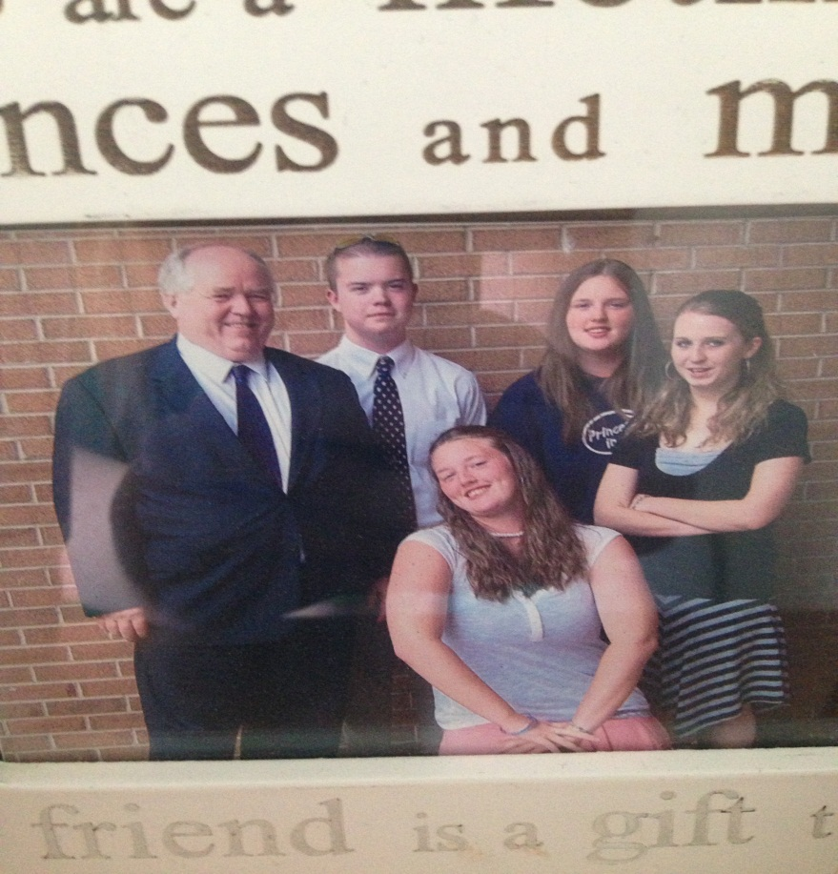
My first semester was very tough. Not being surrounded by those who love me and support me. It was a huge culture shock and reality check for me. I hated it so much when I went home for Christmas I decided to take all my classes that Spring online. Being home that break I lost one of the best men I have ever met. He was my seminary teacher and branch president at the time. He died unexpectedly from a heart attack. My heart broke for I would miss him a lot. A man who knew school out West would be good. Separating form my twin would be good; A man who taught me how to dress when going to a church meeting out West and a man who loves my branch and every single soul there. I knew where he was because of what he taught me.

Slide 11
I would make another hard trip our West for my third semester. I drove this time with my grandmother and her sister. It was such a fun trip! I am thankful for the time I spent with them and for the opportunity my grandmother got to see the West. After completing this semester I would go home for Christmas. Going home is the best because of the love. This break, though, I would lose another amazing man in my life, my uncle Dave. He lived across the road form us and was a very strong example to me and was the last brother my papaw had. At this heart breaking time I developed a fear of death. I am so scared of losing the ones I love.

Slide 12
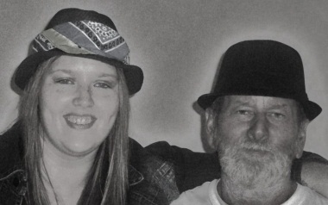
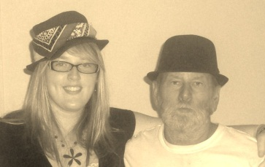
My grandfather would decide to be baptized around this time too. It was an answer to many of my prayers, fasts and dreams. The told him the devil would work against him a lot here he replied with “he will not get me”. My papaw went to a heart doctor appointment though and ended up having a triple by-pass surgery!! It was a huge shock but the family was told tragedy would have stuck twice if he had not gone in. It was a scary thing to see him there especially after recovery because he is my hero and I knew I need him forever. He would be recovering on my 20th birthday but it was ok, As long as he was ok.

Slide 13
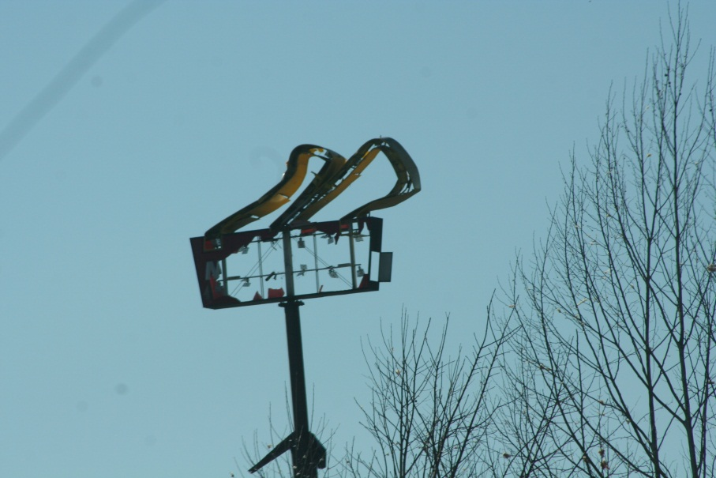
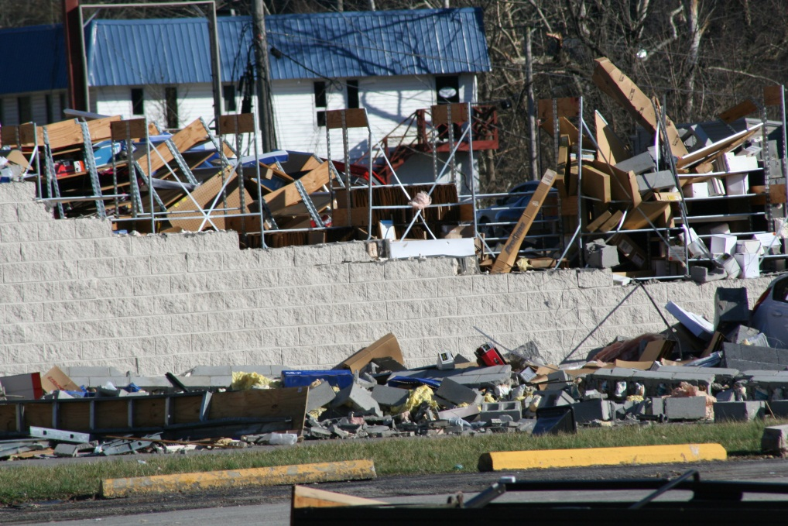
. On his birthday in March that year tragedy would strike our community. Tornadoes would tear apart small towns. It was the craziest thing I have ever seen. I was able to help with the “Mormon Helping Hands” for the second time in my life and it taught me a lot about helping others and always keeping in touch.

Slide 14
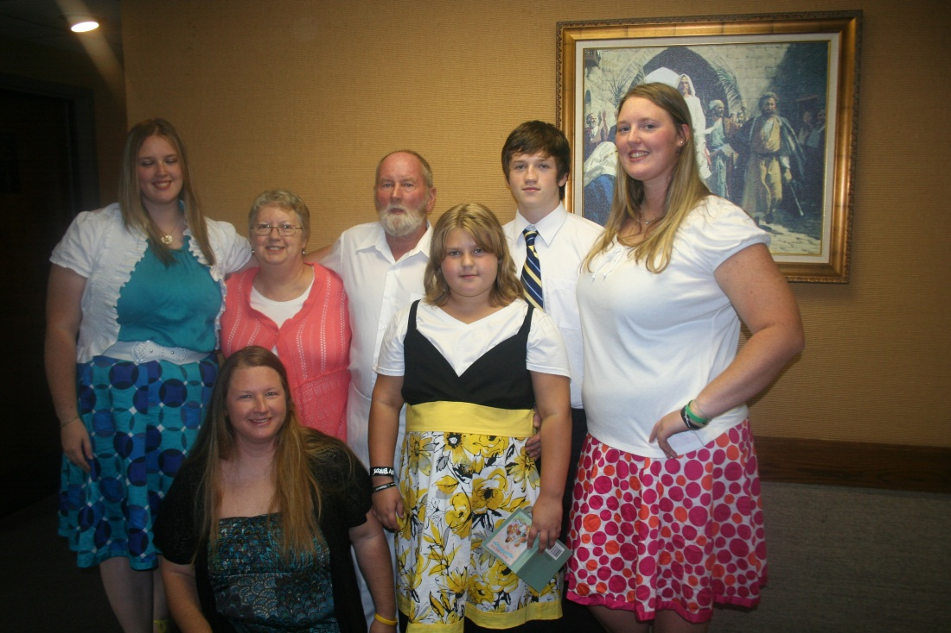
I would go back to school that April and fly home in July for my Papaw’s baptism on August 4th. It was a magical day, the best one to date. This summer he and my grandmother are getting sealed which will be a huge blessing to our family! I also will get sealed to them one day soon. I think about all the horrible luck my family has because it sure is rotten but knowing how incredible they are makes me happy to go through all this incredibly bad luck with them.

Slide 15
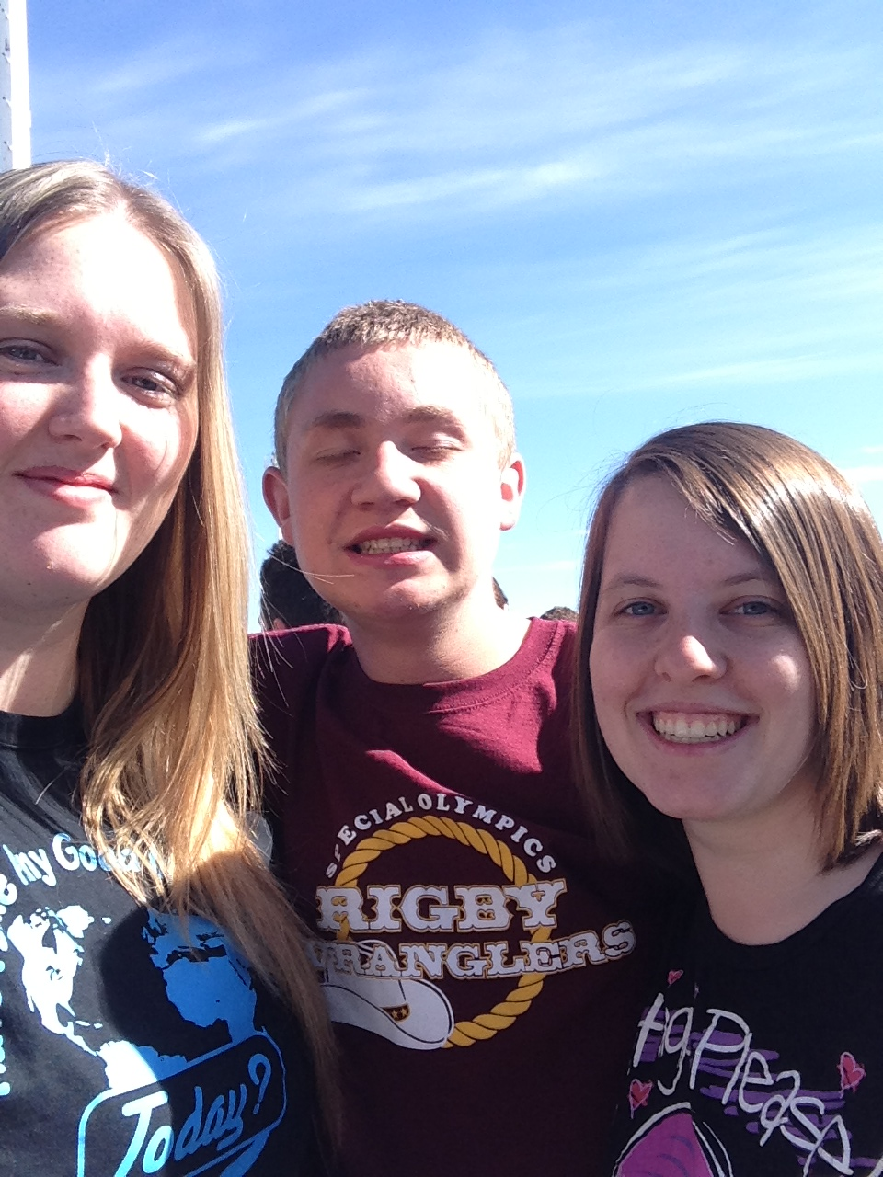
. At this point in my life I am twenty-one years old. I am still going to school at BYU-Idaho where no one thought I would stay. I have tried to transfer but things have gone in a way that I am still here. I am involved with Special Olympics and I know it is something I will always be involved with. It is a program that is so incredible. I love the athletes I have met here in Eastern Idaho and hope to one day coach a team when I am settled down in one place.

Slide 16
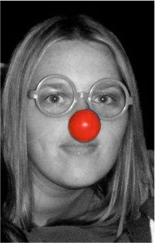
I am struggling with classes and stressing out a lot these days but I am taking it day by day. I am still hoping I can pass the praxis tests and be on my way to earning my degree in English Education. I hope to make my family proud and make an impact in many lives. I want to be someone people admire and that is what I am working towards.

